Slide 1
Covid-19 and how it relates to Vaccination and Death rates
Justice Scott, Chris Kalo, George Reichert

Slide 2
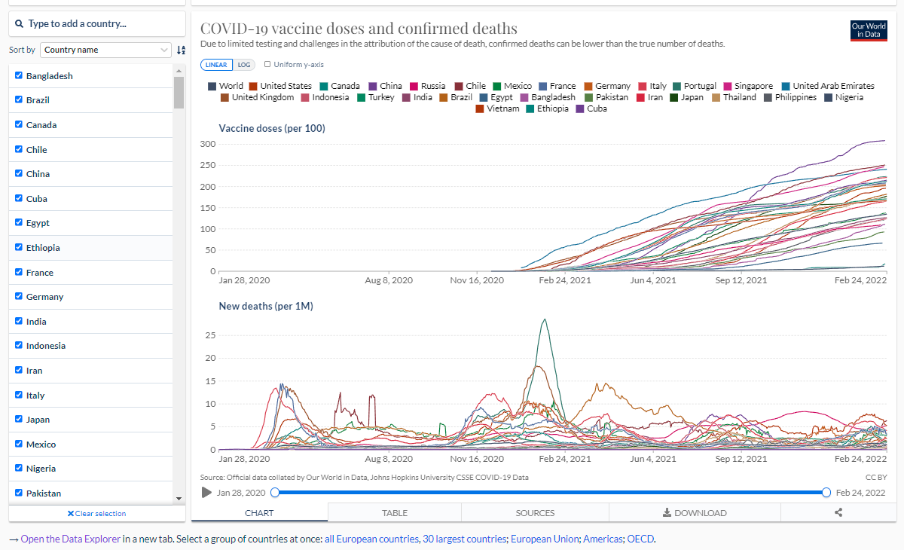
Where we got our data
When it comes to the data presented here, we have data from the ourworldindata.org website. This website is where we got our information on covid-19 information in regard to a number of different things. It maps not only the covid-19 data but also the information about deaths, cases, vaccination, and fully vaccinated status in multiple countries.

Slide 3
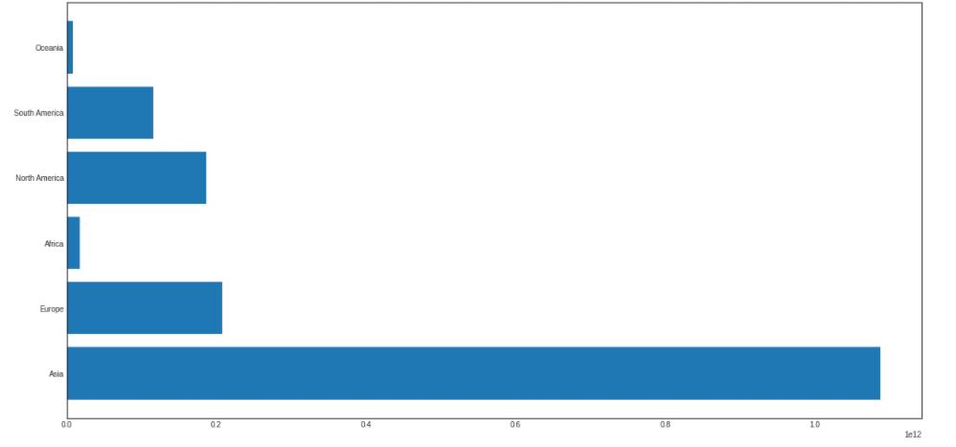

Bar Graph of Vaccinated People by Continent

Slide 4
Displaying Vaccinations
The previous graph currently shows the gross total of vaccinations per continent.

Slide 5
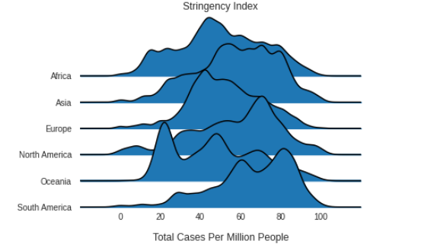
Graph of Covid Stringency Index of Countries Grouped By Continent

Slide 6
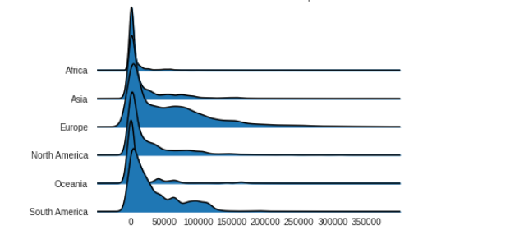
Graph of Covid Total Covid Cases in Countries Grouped By Continent

Slide 7
Comparing Regulations to Cases
The goal of these two graphs was to display the correlation between the stringency index and total total cases graphed by continent.
The original plan was to graph the results by country, but because of the size of the data set, the graph was almost unreadable.
I think that the two graphs do a great job to illustrate that where stringency indexes are lower, the amount of covid cases goes up.

Slide 8
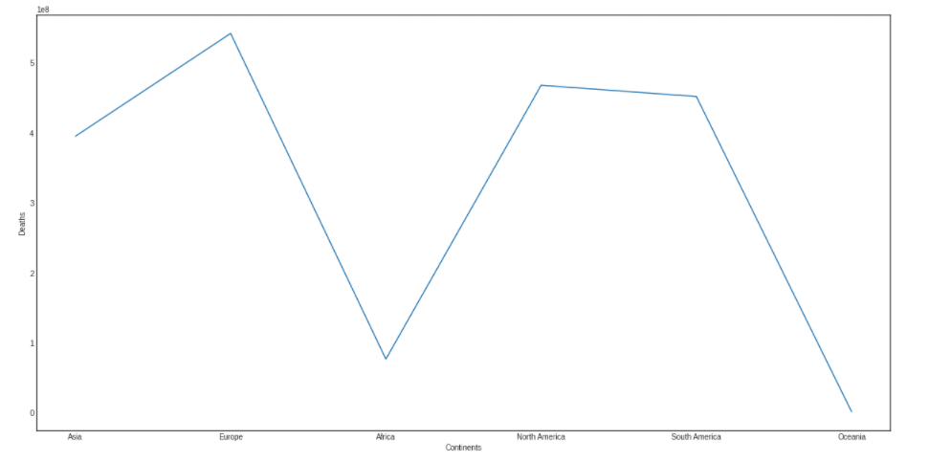

Line Graph Continents/Deaths

Slide 9
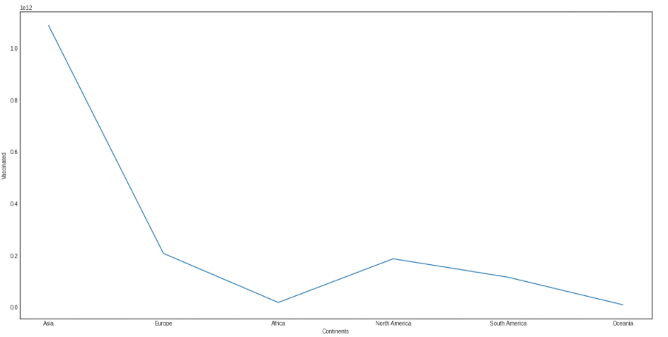

Line Graph Continents/Vaccinated

Slide 10
Line Graphs and what they show us
We can see how each continent has varying levels of the line graph.
When it comes to the death and vaccination on the line graphs, you can see how each one varies depending on the continent.
You can observe how deaths can be higher in certain continents where as vaccines is lower on certain areas of the graphs.

Slide 11

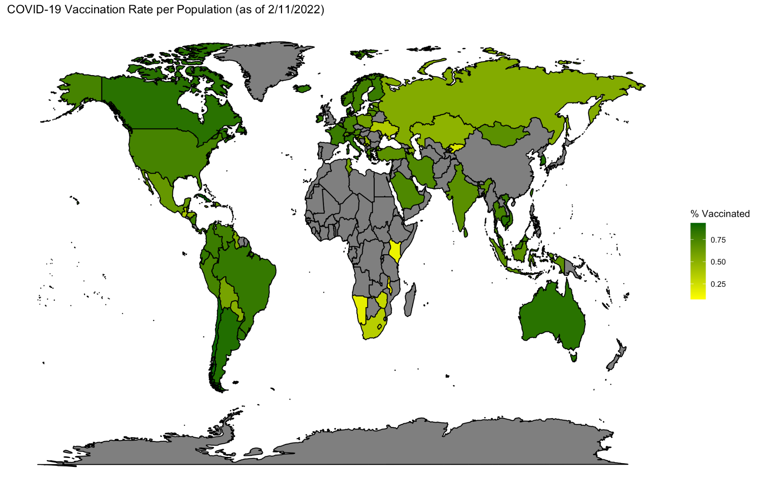
Vaccination Rate Map (in R)

Slide 12
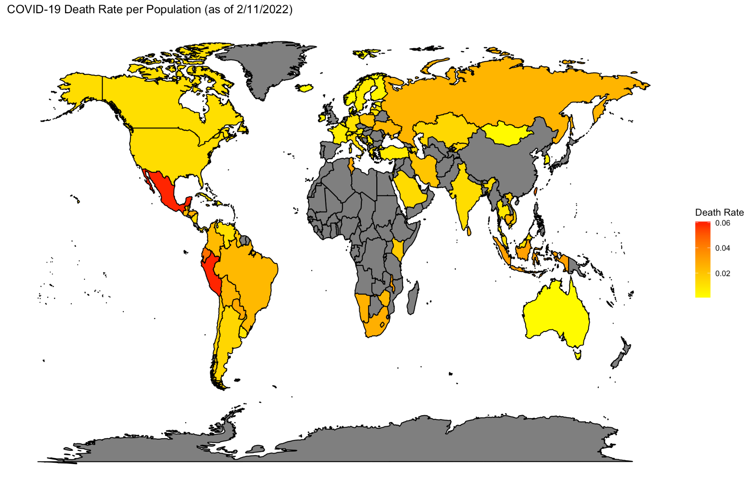
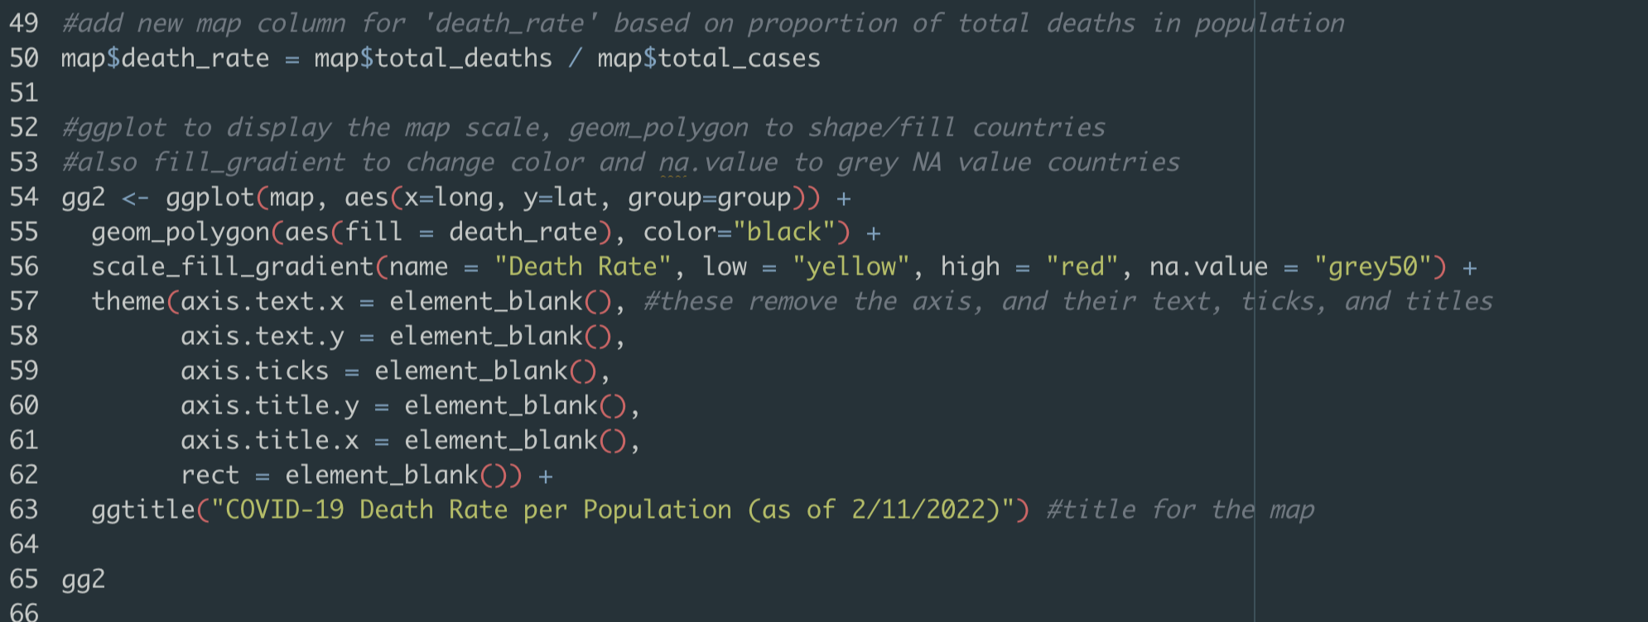
Death Rate Map (in R)

Slide 13
R Maps conclusion
We can conclude that the vaccination rate could be an indicator for lower death rate in major countries, such as USA, Canada, Australia and more. Russia and countries in the South African region has a marginally lower vaccination rate than some major countries, but a higher death rate in turn. However some countries (e.g. Mexico and more countries in South America) have high vaccination rates, but higher (in relativity) death rates when compared to others. This could be because of healthcare standards, hygiene, population density, poverty among some possible reasons.

